Slide 1
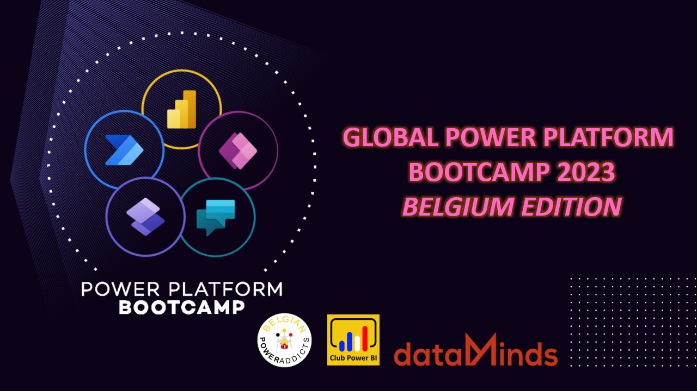

Slide 2
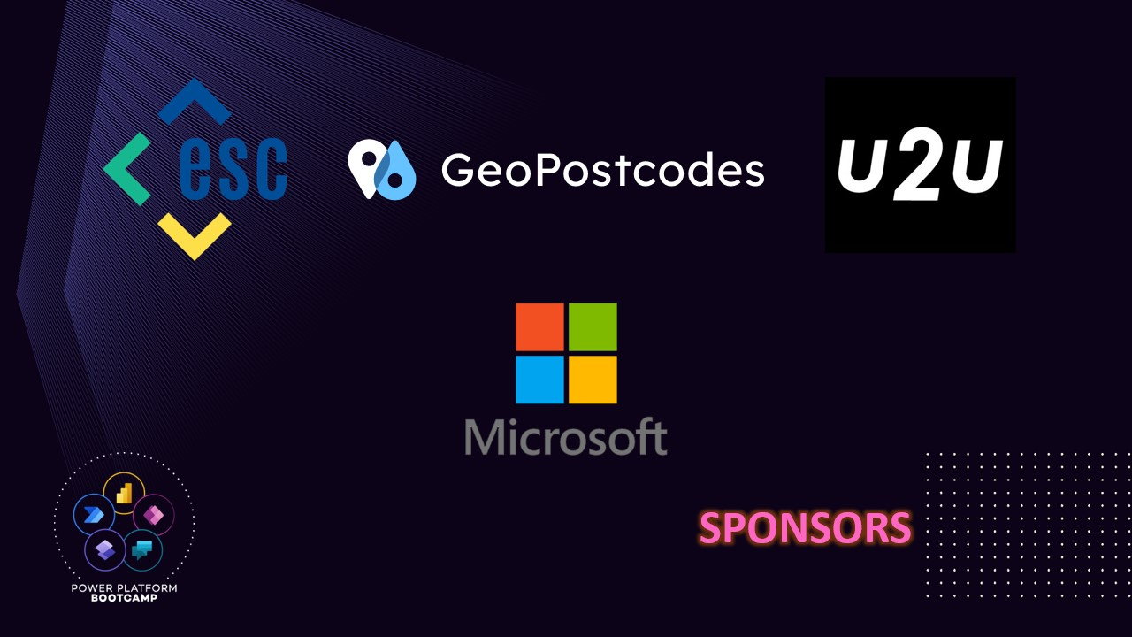

Slide 3
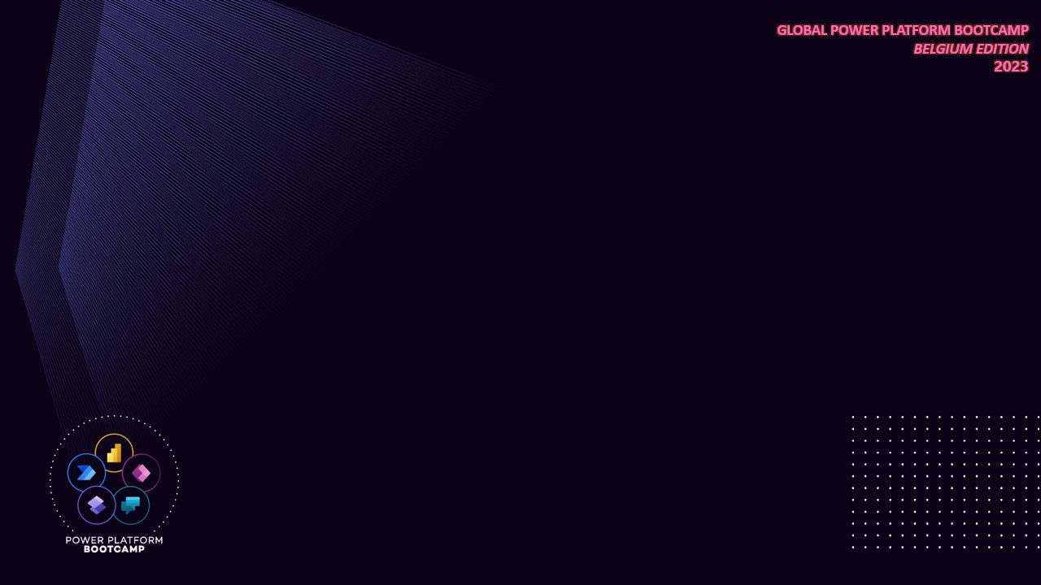

”Jean Cloud”
Solution Architect @ Dexmach
Jan
Van Meirvenne

Slide 4
Enabling Citizen Developers using Custom Connectors
Extending traditional development into the low-code movement

Slide 5

[Content Page]

Slide 6

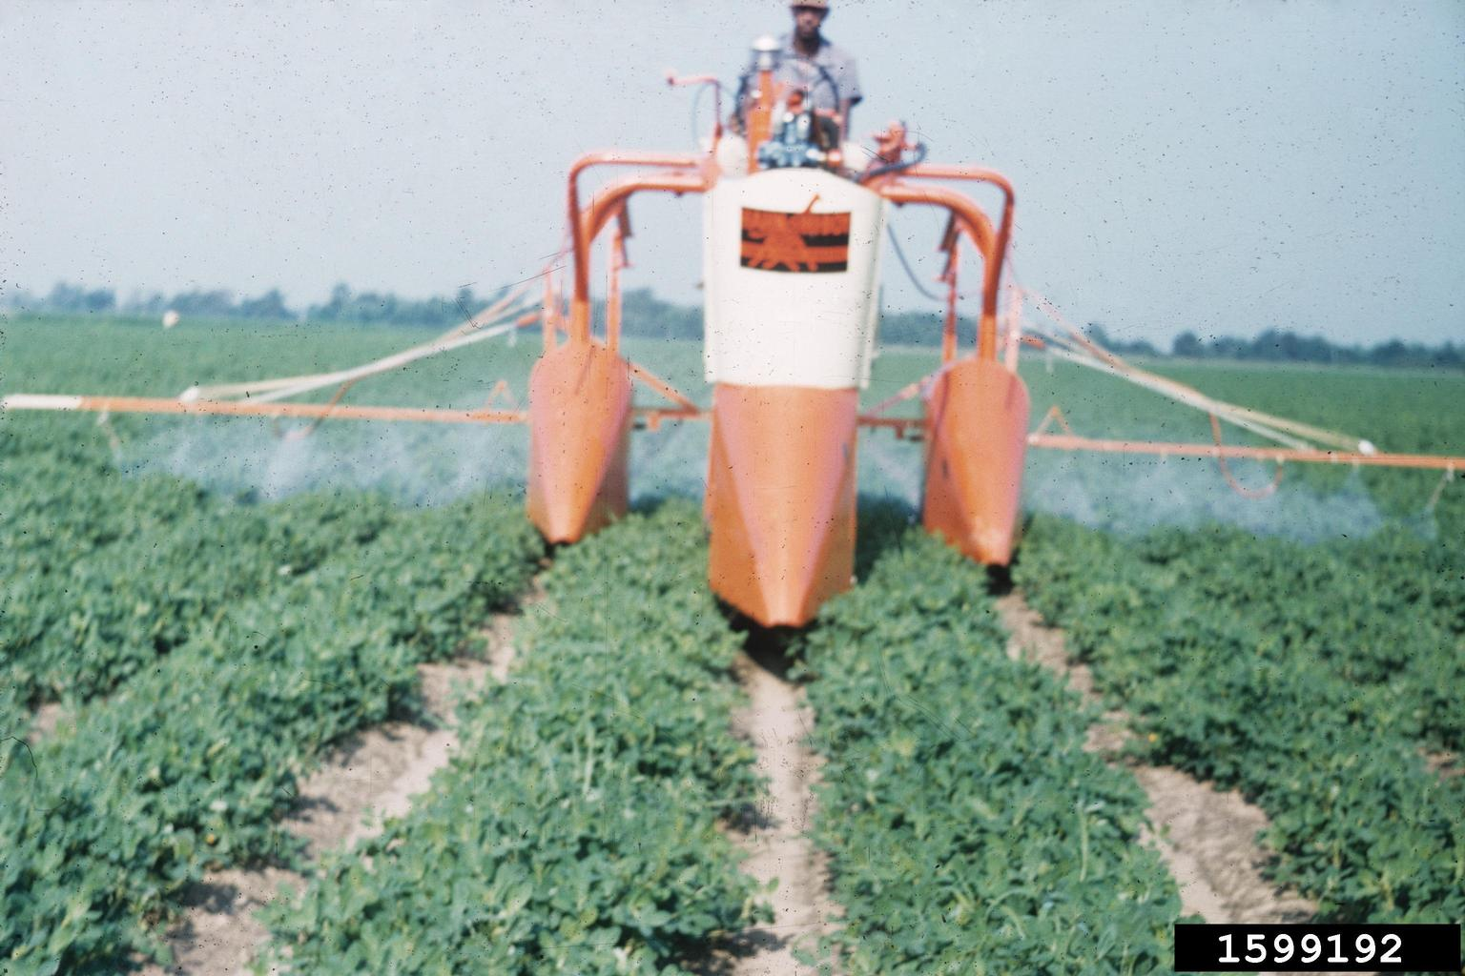
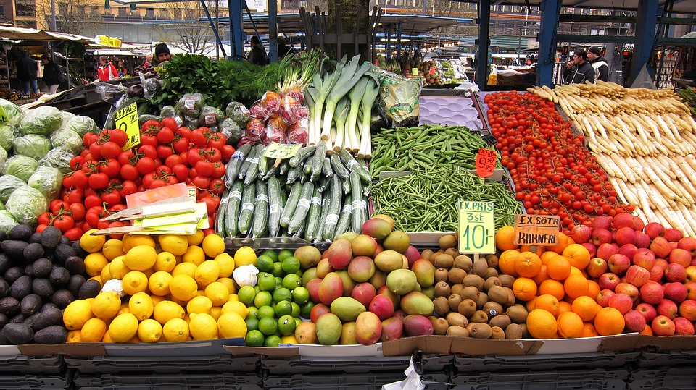

Agenda
What & Why Citizen Development
Grow open applications – developers
Protect the food chain – IT infrastructure
Make it available – integration team
Consume – the business

Slide 7

This is not a prisoner
This is a developer, a rare breed quickly becoming extinct
due to continuous workload increases in his habitat
They can only be found in captivity
of their own time
constraints

Slide 8




2021: 1.4 million developers shortage (90.8% capacity)
2025: 4.0 million developers shortage (84.9% capacity)
Potential solutions:
Make it easy to learn to code
Make it easy to code (citizen development)
Combine both for a sustainable synergy
Source: International Data Company - Quantifying the Worldwide Shortage of Full-Time Developers (idc.com)

Slide 9

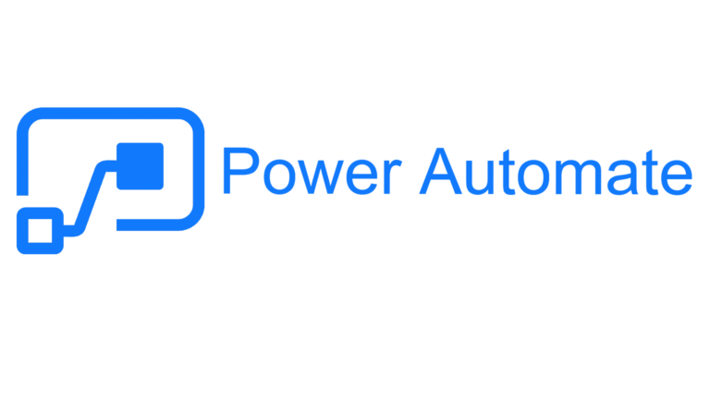

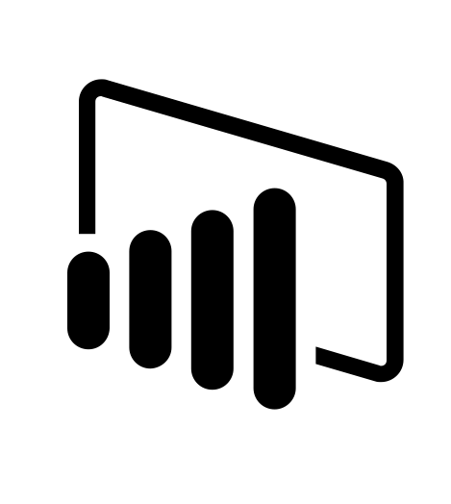
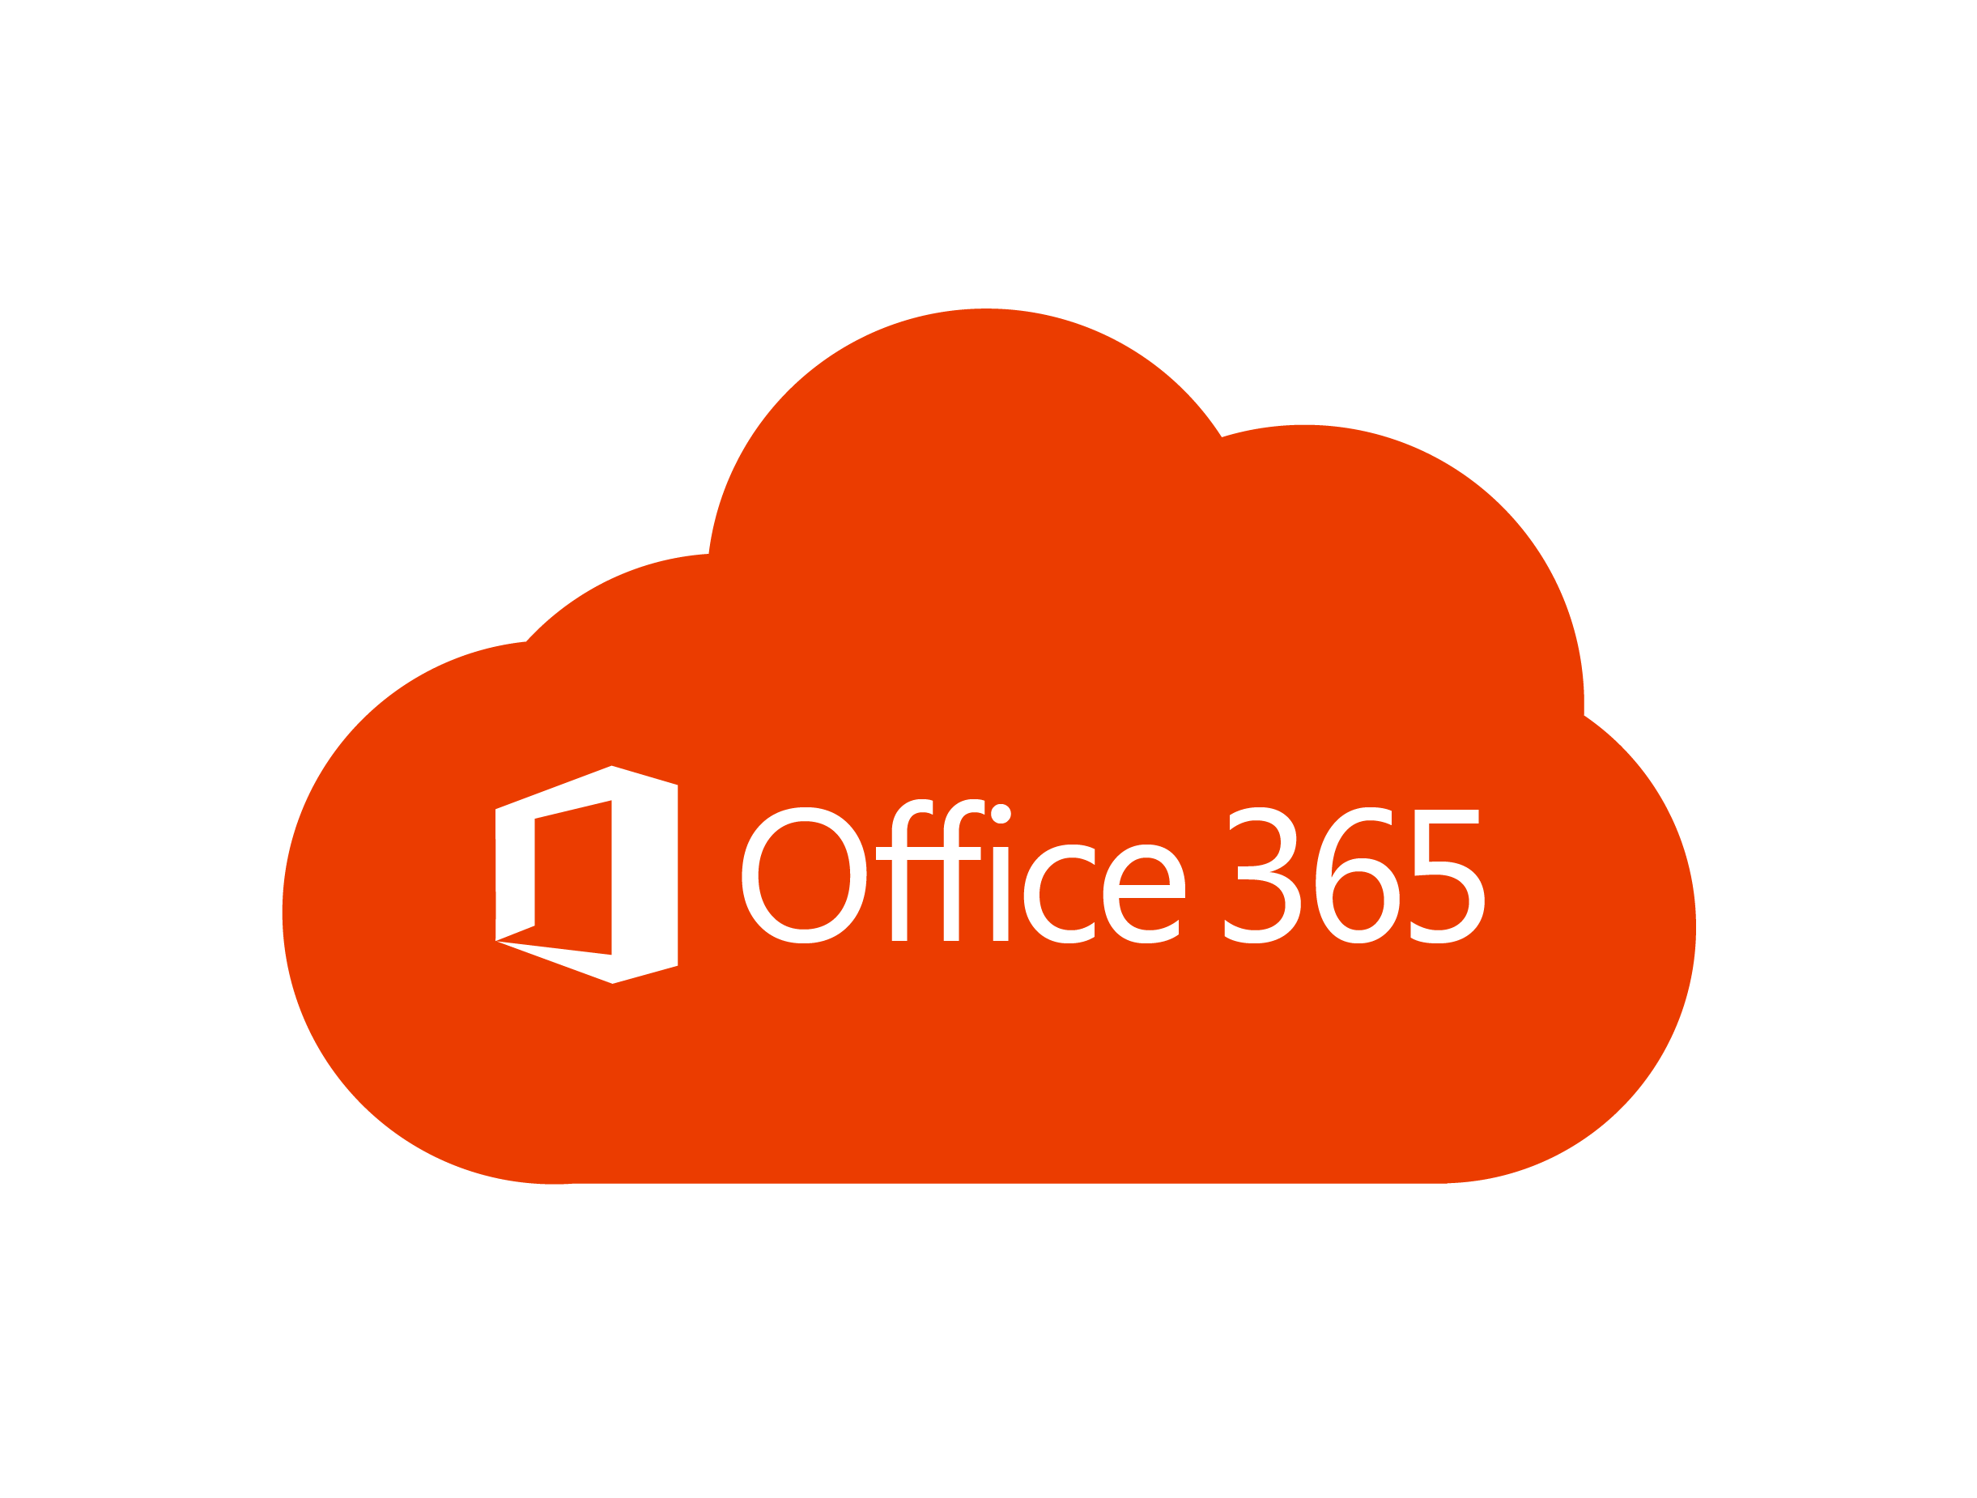
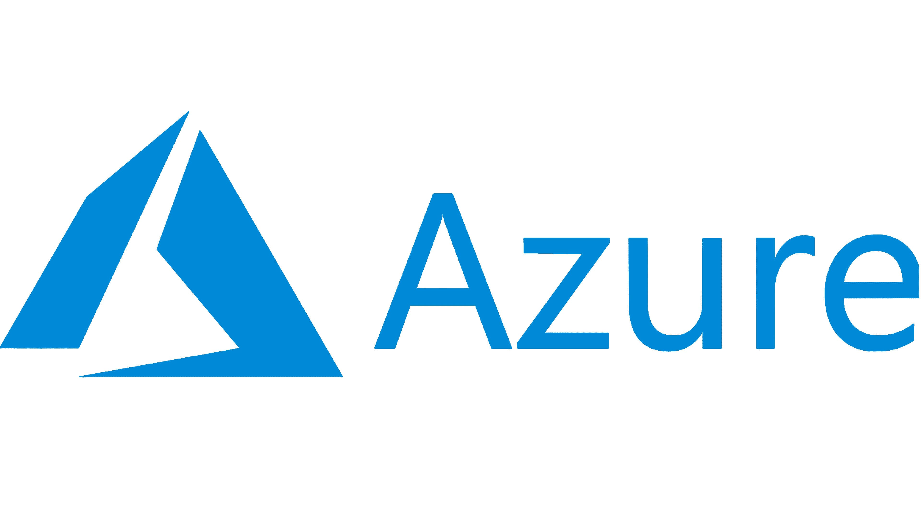
The Power Platform
Power Apps | Power Automate | Power Virtual Agents | Power BI
Scalable interfaces | Versatile Automation | Embeddable Bots | Self-service insights
integrate
integrate
Power Platform Connector Framework
Power Query Framework
3rd party connectors
Your apps?

Slide 10

Grow Open Applications
Greenfield
Write
Monolith
“Micro”services *
Graphical Interface
Business Logic
Data
Refactor
Rewrite
Proxy
Graphical Interface(s)
(Web) API 1 ..n (documented)
Brownfield
Business Logic 1..n
Datastore 1..n
* Injecting API’s between graphical interfaces and business logic is key to enable cros-app integration!
Developer

Slide 11
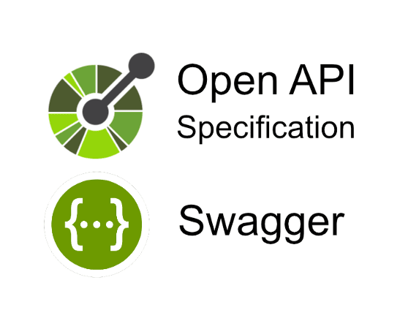
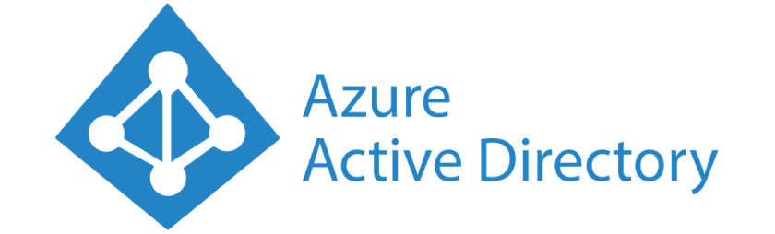
Introducing: Yet Another Todo App
Create Task
https
Complete Task
https
Users
Tasks
Webhooks
Get
Tasks
Access token
https
Create Webhook
https
Delete
Webhook
https
Authentication /
Authorization
Data Model
API
Documentation

Slide 12
Protect the food chain
Private
Public
Power Gateway
Yet Another Todo
Power Platform
API
Manager
throttling
IP filter
Auth
Logs
Docs
Expose only to where and who is supposed to use them!
IT Infrastructure

Slide 13

Make it available
Or basic auth, anonymous, api-key etc but not recommended!
+ logic apps on Azure!
Custom Connectors
Yet another todo
Share inside Power Platform
Monitor Task (webhook)
Create Task
Complete Task
List Task
consumers
Create Webhook API
Delete Webhook API
Create Task API
Complete Task API
List Task API
Power Query Framework
List Task
Share as plugin (desktop or powerbi gateway)
consumers
(Enterprise) Integration Team
With proper openapi docs, 80% is automatically generated!

Slide 14
Consume
It would be great if…
Monitor Task
Create Task
Complete Task
List Task
Yet another todo
API
Connector
Network Protection
Single-Sign On
I could complete a task via chat
I could create a performance report of my tasks
I could have a mobile app to manage todo’s on the go
Business / Citizen Development Center

Slide 15
But what about…
…applications that are “death field” but irreplacable?
Time to make it replacable :)
McGyver solution: Consider robotics via PowerAutomate Desktop Flows (bonus demo!)
Licensing
All custom connectors are ”Premium” and require per-app or per-user licensing
Certifying my connectors?
If you are an ISV or integrator, go for it, but mind requirements!
Don’t bother for internal applications

Slide 16
Recap
Grow open applications – developers
Protect the food chain – IT infrastructure
Make it available – integration team
Consume – the business
Think big, start small, go fast

Slide 17
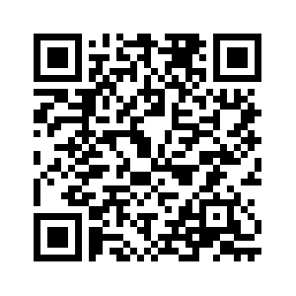
Check it out for yourself!
JeanCloud365/Global-Power-Platform-Bootcamp-2023 (github.com)

Slide 18


Slide 19
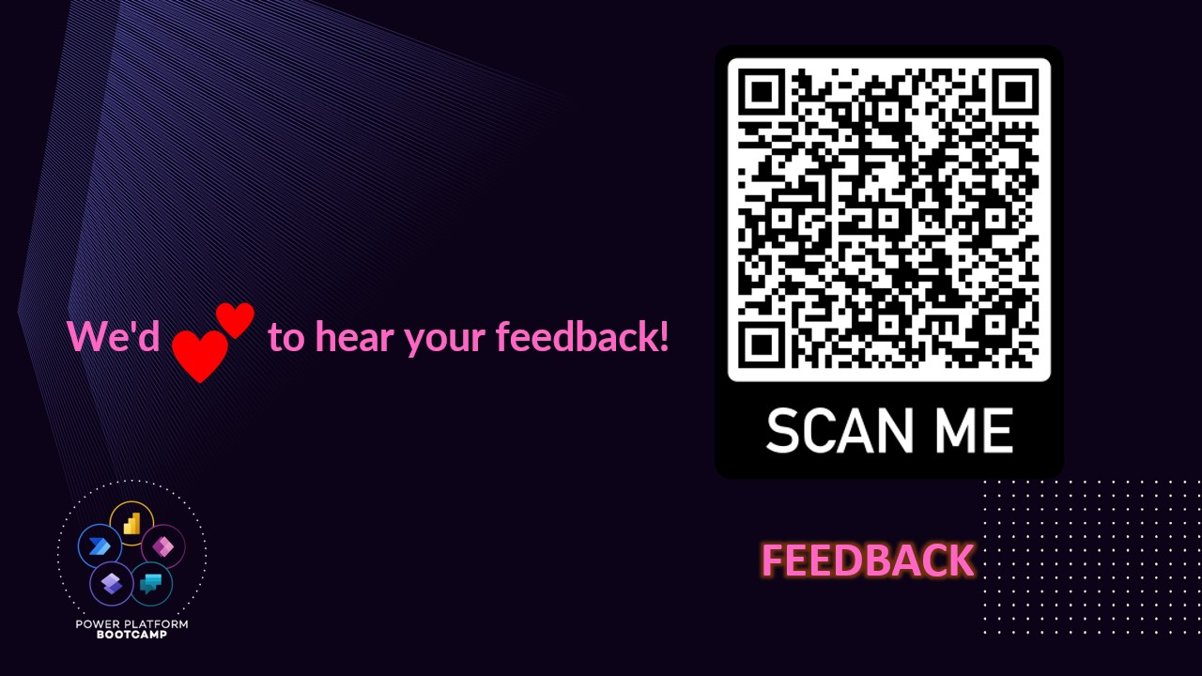

Slide 20
